Slide 1
EGC221
Class Notes
9/1/2021
Baback Izadi
Division of Engineering Programs
bai@engr.newpaltz.edu

Slide 3


Slide 5
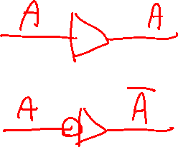

Slide 6
